Slide 1
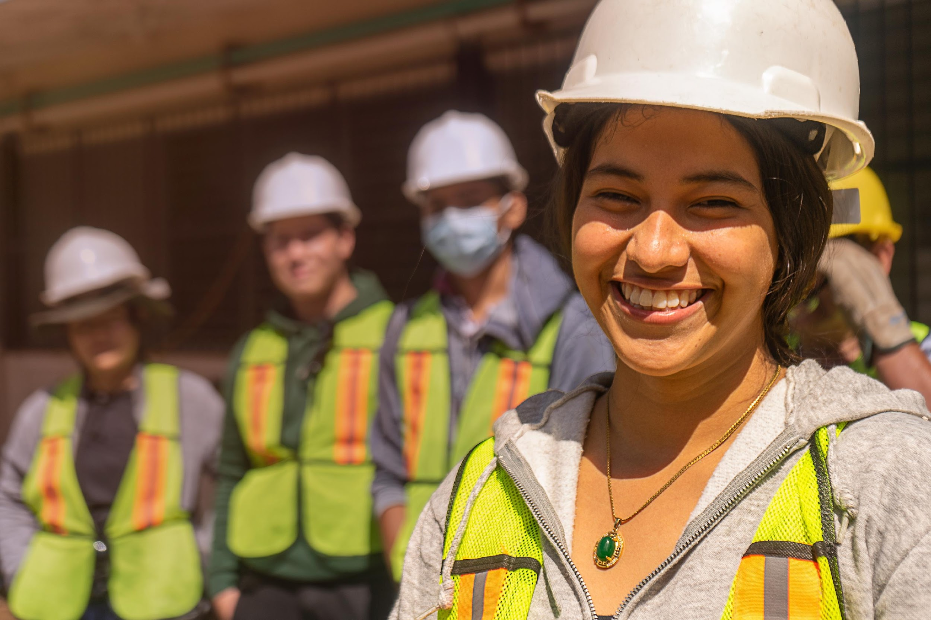
Massachusetts Climate Careers: Powering the Future
High-Performance Buildings
|
1

Slide 2
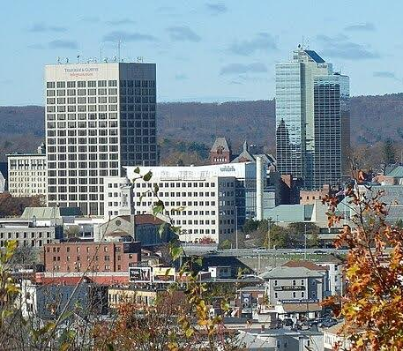
Buildings and
Climate Change
Buildings are the second-largest source of greenhouse gas emissions in Massachusetts.
Notes:
Buildings in Massachusetts use 54 percent of the state’s primary energy each year, making them the state’s second-largest source of greenhouse gas emissions.

Slide 3
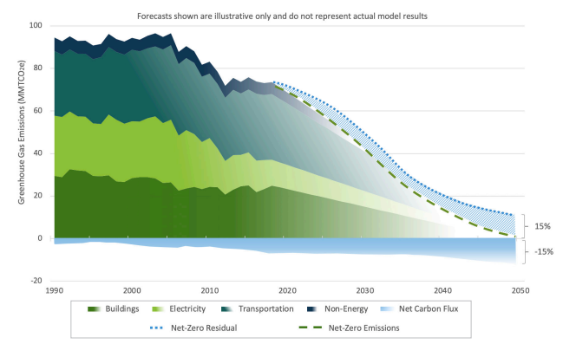
Buildings Can Be Climate Solutions
Massachusetts aims to reduce greenhouse gas emissions from buildings by 50% by 2030 and achieve net-zero emissions by 2050.

Slide 4
Opening Activity
Discuss this question with a partner:
Does it require more energy to cool a building in summer or heat a building in winter?
Notes:
Activity objective: Working in pairs and based on knowledge gained in previous lessons, students are to come up with a theoretical answer to a complex building performance question.
Instructions:
Divide students into pairs or ask them to find a partner.
They will have two minutes to discuss this prompt: What do you think uses more energy—heating or cooling a building? They should use anything they’ve learned about energy-efficiency so far in this class to weigh their answers.
After 2–3 minutes, bring their attention back to the full class for group debrief:
Call on pairs to share if they have come to consensus.
Ask for students to raise their hands if they think it takes more energy to heat a building.
Then, for students to raise their hands if they think it takes more energy to cool a building.
This is a bit of a trick question since many factors go into determining the answer, including where your building is located.
Transition: Today we’re going to talk about the challenges of making buildings more energy-efficient, and some of the materials and strategies that create high-powered buildings of all kinds.

Slide 5
The Big Question and My Climate Goals
Climate Watch and Discussion
High-Performance Buildings
Today’s Group Activity
Takeaways and Closing

Slide 6
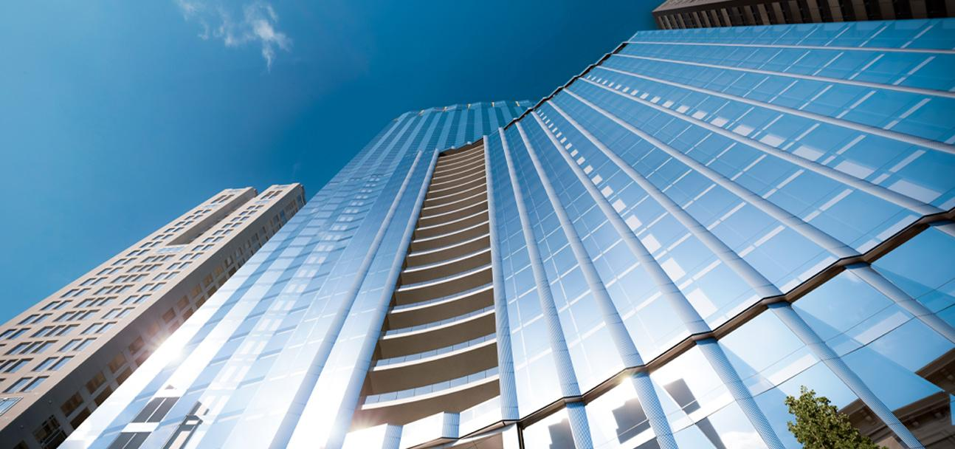
How can we use different materials, designs, and processes to ensure that new buildings are part of our climate solutions?
Notes:
Ask students for one example of something they’ve seen that helps reduce emissions at home or at school.
Those could all be examples of climate technologies.
Today, we’ll explore technologies that make everyday spaces more sustainable and energy efficient.

Slide 7
My Climate Goals
When you complete this lesson, you’ll be able to
Explain the importance of energy-efficient building design, construction, and materials and their role in fighting climate change
Identify examples of climate-critical professionals designing and implementing solutions for new buildings to contribute to our net-zero goals
Describe some characteristics of LEED-certified and Passive House buildings and how they differ from most current buildings.

Slide 8
Climate Watch: Video
Coming soon
Courtesy XXXXXX
Courtesy of XXX
Notes:
Video expected by Spring 2025.

Slide 9
What are some examples of Passive House design elements shown in the video?
How would you describe the goal of Passive House design for energy efficiency?
What did you learn from this video? What does this video make you want to learn more about?
Climate Watch Discussion

Slide 10
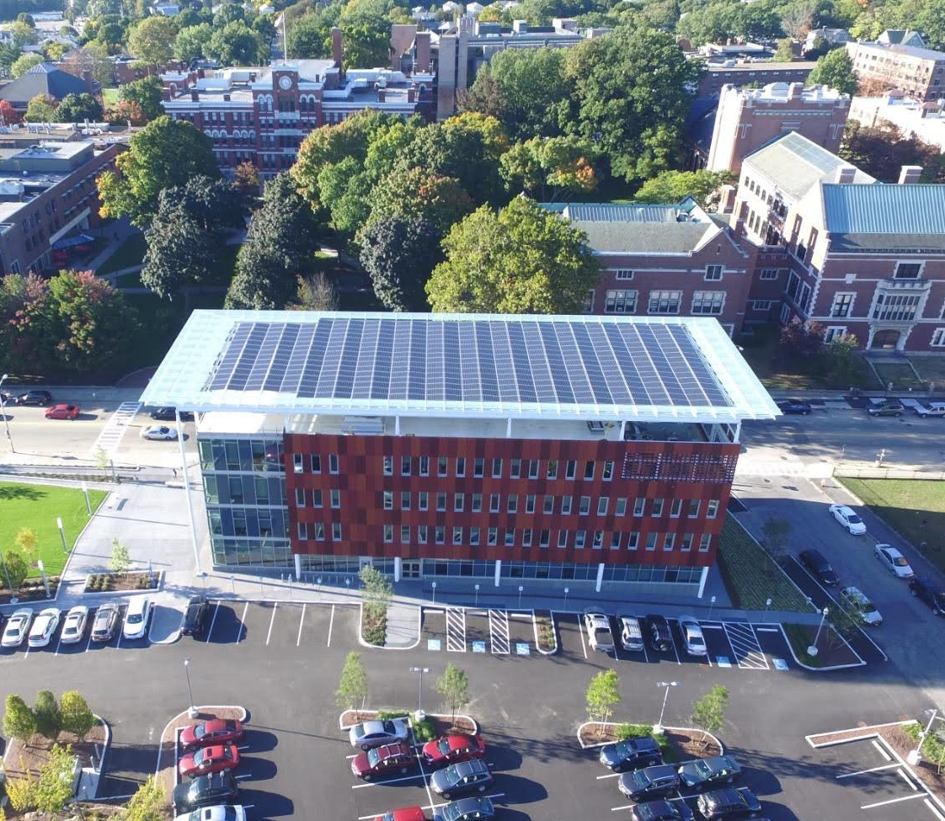
High-Performance Buildings
Energy-efficient buildings use less energy, save money, and help fight climate change.
Clark University
Worcester, Massachusetts
Courtesy of Solar Design Associates
Courtesy XXXXXX
Notes:
High-performance buildings are an essential solution in our fight against climate change.
Buildings, when designed with sustainable materials, energy-efficient systems, and on-site power generation such as solar arrays, significantly reduce emissions over the lifetime of the building.
Can you name some careers that are essential to developing high-performance buildings that are climate solutions?

Slide 11
More than a Building
High-performance buildings use less energy and can even generate energy!
Features might include:
Landscape design
Passive solar design
Insulation and building envelope
Heating, ventilation, and air conditioning (HVAC) systems
Smart building technology
Water efficiency
Renewable energy sources
Lesson 4: High-Performance Buildings
Notes:
High-performance buildings use less energy and can even generate their own energy! Here are some key features of high-performance buildings:
Landscape and site design: A well-designed surrounding landscape that uses shade trees and thoughtful building placement on the site reduces energy requirements.
Passive solar design: Using the building orientation or overhang design, create energy-efficient structures.
Insulation and building envelope: A tightly sealed and well-insulated and built building envelope reduces energy needs.
Heating, ventilation, and air conditioning (HVAC) systems: High-efficiency, electric HVAC systems save energy and can be powered by renewable electricity.
Smart building technology: Programmable thermostats, smart lighting, and energy monitoring systems help optimize energy use.
Water efficiency: Fixtures that reduce water usage, such as low-flow toilets and showerheads, reduce water use in homes and commercial buildings.
Renewable energy integration: Clean energy sources such as solar can meet a building’s energy needs and reduce dependence on fossil fuels.
Ask the students which of these they are familiar with. Who has seen some of these in their homes? Here at school?
Image source: Phius, a non-profit committed to decarbonizing the built environment

Slide 12
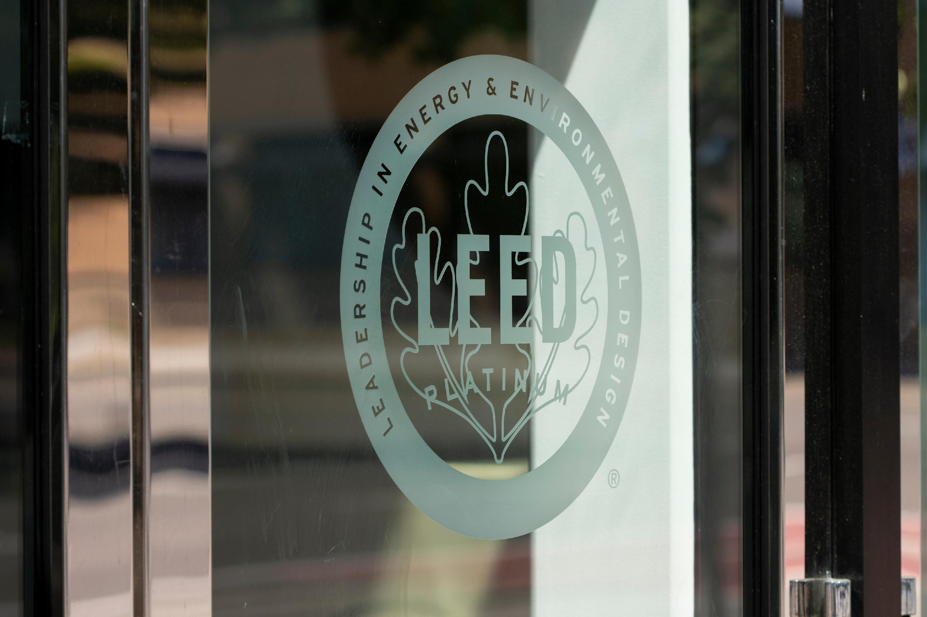
Certifications
LEED certification (Leadership in Energy and Environmental Design) focuses on sustainability and promotes eco-friendly practices.
Passive House design focuses on energy efficiency.
Lesson 4: High-Performance Buildings
Notes:
Certifications can be necessary for establishing and maintaining standards for reducing emissions.
This is especially significant as states, cities, and even countries worldwide set ambitious goals to lower emissions, creating a global movement toward greater energy efficiency.
These certifications help ensure that the same efficiency standard is met and those goals are achieved.
There are two main types of certifications for high-performance buildings:
LEED certification recognizes buildings designed and constructed to be environmentally friendly and sustainable. It considers factors such as energy efficiency, water usage, and materials to promote eco-friendly practices. Its primary focus is on sustainability.
Passive house is a design standard when a building minimizes the energy required for heating, cooling, and lighting. It focuses on design, siting, materials, insulation, airtightness, and ventilation to create efficient and healthy buildings.

Slide 13
Careers in Energy-Efficient Construction
Architects and designers
Engineers
Building contractors
Equipment operators
Carpenters, electricians, plumbers
Roofers
Insulators
HVAC contractors
Building automation contractors
Building inspectors
And more!
Notes:
Many careers are part of making buildings climate-friendly; these are some of the common ones you may have heard of , and we will see again throughout this course.

Slide 14
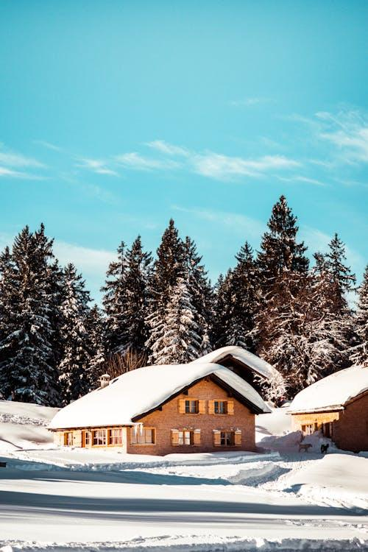
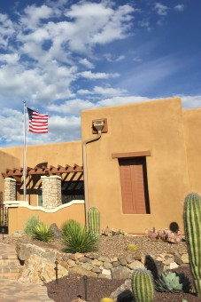
Today’s Group Activity
Design Green Buildings for Different Climates
Cold Climate
Desert Climate
Tropical Climate
Coastal Climate
Lesson 4: High-Performance Buildings
Notes:
Activity objective: Invite students to apply what they’ve learned about high-performance buildings and the unique properties of green building materials to the needs of different climates, and introduce some of the skills necessary for designing climate-appropriate high-performance buildings.
Activity explanation: In groups, students will have ten minutes to design a high-performance building for their assigned climate using the information provided on their worksheets and what they’ve learned today. Students are encouraged to think outside the box and be creative! After ten minutes, each group will present their building to the rest of the class.
Instructions:
Divide the students into four groups and assign each group one of the four climates on the slides and worksheet: Cold, Desert, Tropical, or Coastal. Depending on the number of students in the class, you may divide students into smaller groups and assign multiple groups to the same climate to keep groups to four students or less.
Working together, groups should do the following:
Review the environmental demands and challenges their climates present for energy-efficient buildings detailed on their worksheets.
Think about what challenges buildings face in different climates. What makes a building energy-efficient in a cold climate vs a hot climate or a coastal climate?
Identify materials and technologies they would use in their buildings to make them as energy-efficient as possible for their assigned climate. For example, buildings in cold climates need to retain heat, while buildings in warmer climates require ways to stay cool.
Focus on three features they want to include in their building. Features should focus on saving energy and reducing emissions.
Prepare to explain how each feature helps your building save energy and why it’s appropriate for your climate.
Sketch or design their building and its features (as time allows).
Key Point to emphasize: Adapting buildings to different climates is essential for reducing emissions and improving energy efficiency worldwide. Clean energy and energy-efficient technologies are not a one-size-fits-all solution.

Slide 15
Group Presentations
How is your climate challenging for energy-efficient buildings?
What energy-efficient features does your design include?
How do these features make your building a high-performance building?
Notes:
Presentations/debrief discussion:
Invite each student group to share the highlights of their design, focusing on these three questions:
What challenges did they need to address in their climate?
What three energy-efficient features did they include in their design?
How do these features contribute to a high-performance design?
After all the groups have presented, if time allows, ask one or two students:
What did you learn about designing buildings for different climates?
What was the biggest challenge about designing a building for your climate?
Key point to emphasize: Adapting buildings to different climates is essential for reducing emissions and improving energy efficiency worldwide. Clean energy and energy-efficient technologies are not a one-size-fits-all solution.

Slide 16
High-performance buildings are designed to use less energy, improve comfort, and reduce environmental impact.
Key features include energy efficiency, renewable energy integration, and smart technologies.
Equitable design ensures benefits for all communities, including disadvantaged ones.
Notes:
High performance buildings help achieve climate goals by lowering emissions and promoting sustainability.

Slide 17
Closing Activity
c
If you had more time, what additional energy-saving element would you add to your green building design?
What role do you see yourself playing in creating energy-efficient buildings?
Lesson 4: High-Performance Buildings
Notes:
Go around the room and ask students to answer these questions.
For the second one, they might have no interest in this type of work professionally; it might just be that they want to have a home that is energy-efficient, or perhaps they want to make sure their workplace uses green energy sources.

Slide 18
High-performance buildings aren’t the buildings of the future; they’re the buildings of today. They’re an essential solution in mitigating the impacts of climate change.
|

Slide 19
Climate Vocabulary Deep Dive
LEED certification recognizes buildings that are designed and constructed to be environmentally friendly and sustainable. It considers factors such as energy efficiency, water usage, and materials to promote eco-friendly practices.
Passive House is a design concept that creates high-performance buildings that minimize the energy required for heating, cooling, and lighting. It focuses on design, siting, materials, insulation, airtightness, and ventilation to create efficient and healthy buildings.
Building siting, or the location and orientation of a building, affects its energy efficiency by optimizing factors such as sunlight exposure, wind patterns, and natural shading. This influences heating, cooling, lighting requirements, and solar generation potential.
Lesson 4: High-Performance Buildings
Notes:
Optional Extension content.

Slide 20
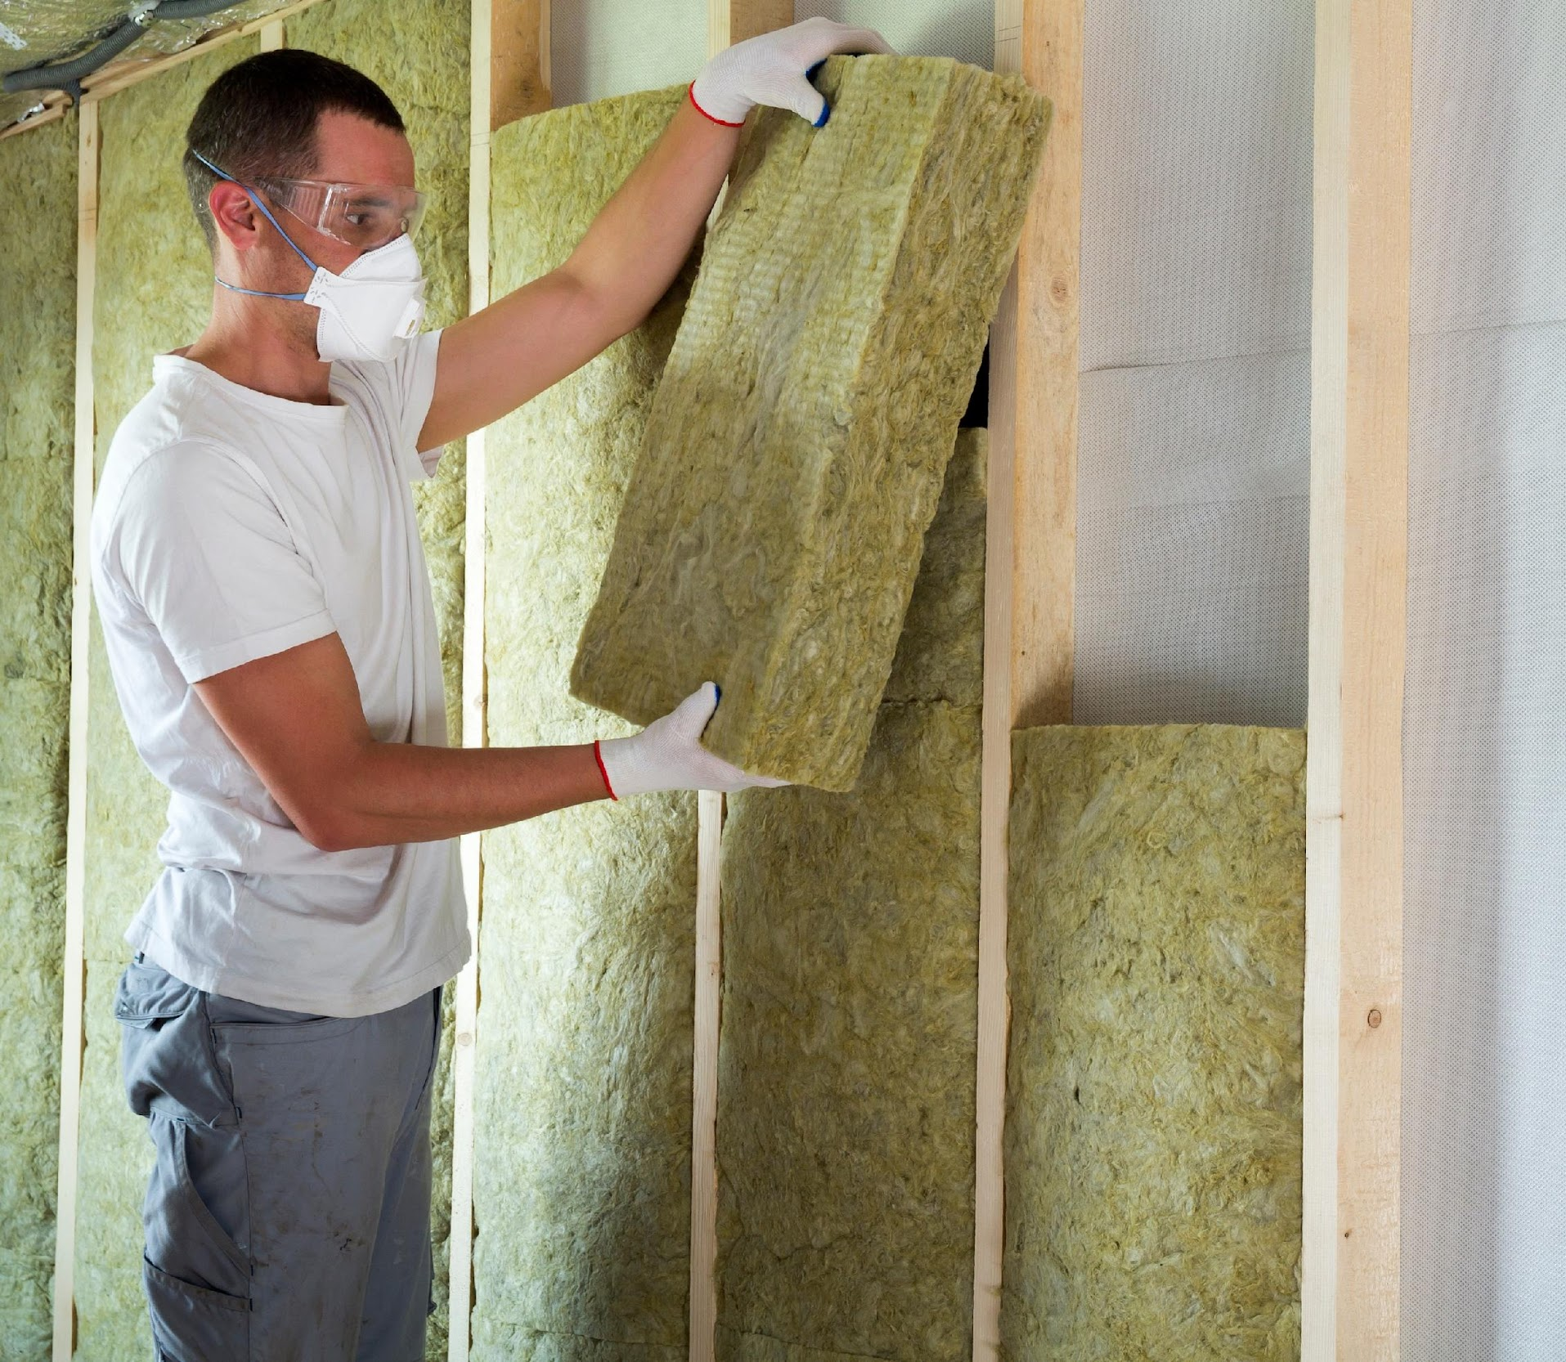
Climate Vocabulary Deep Dive
Building envelope describes the protective skin around a structure consisting of walls, roofs, and floors. It protects against weather elements, controls temperature, and impacts a building’s efficiency and energy use.
Insulation is a material installed in walls, floors, and ceilings to regulate indoor temperatures, conserve energy, and reduce noise transmission. It enhances comfort and decreases energy use in buildings.
Air infiltration is the uncontrolled and unwanted movement of outdoor air into a building through gaps, cracks, or openings in its structure. It can lead to energy loss and decreased indoor comfort.
Lesson 4: High-Performance Buildings
Notes:
Optional Extension content.

Slide 21
Climate Vocabulary Deep Dive
Solar gain is the process by which sunlight enters a structure, warming its interior. It helps reduce heating costs in winter but can increase cooling needs in summer without proper management.
Daylighting is the designed use of natural light to illuminate indoor spaces, reducing the need for artificial lighting. It enhances visual comfort, saves energy, and promotes a healthy indoor environment.
Smart homes and buildings use internet-connected devices to automate and control appliances and systems such as lighting, space, and water heating, and other devices to improve energy efficiency, comfort, and convenience.
Lesson 4: High-Performance Buildings
Notes:
Optional Extension content.

Slide 22
Climate Vocabulary Deep Dive
Build a Climate Word Wall
With your partner or small group, discuss your assigned vocabulary term. Consider the technology's significance and one practical application or benefit.
Together, present your term to the class. Explain the technology's importance and its application in your own words.
Affix your term to the word wall.
Lesson 4: High-Performance Buildings
Notes:
Optional Extension content.

Slide 23
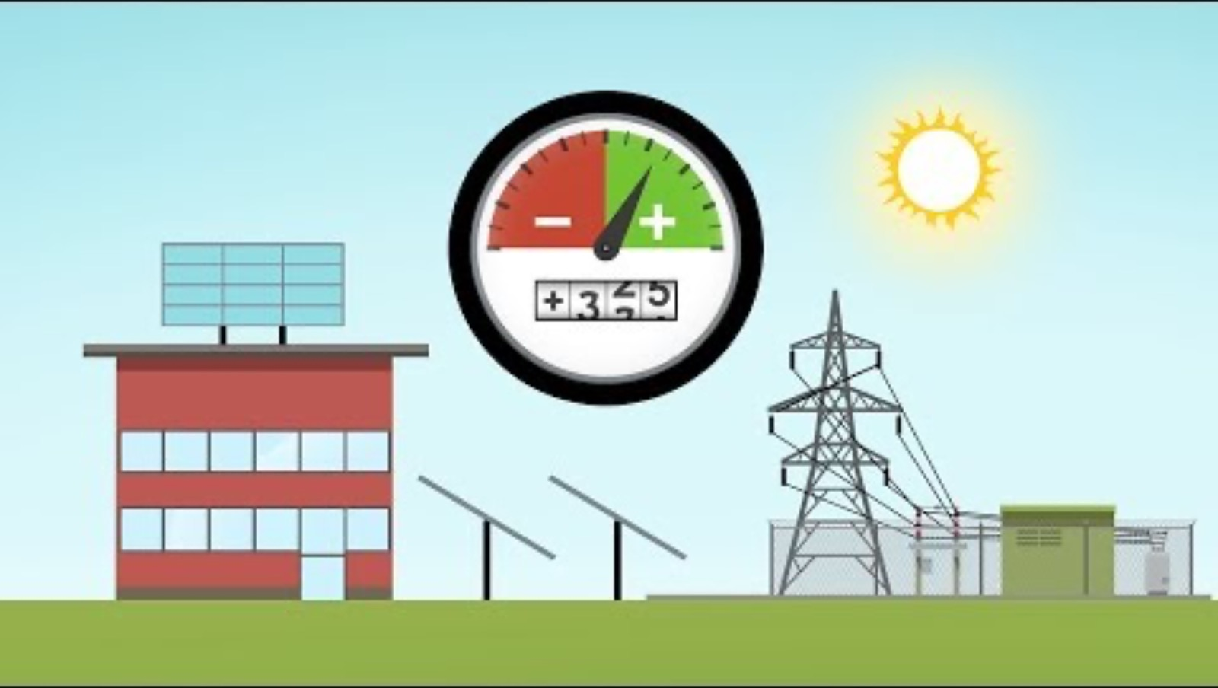
Climate Watch: High-Performance Zero Energy Buildings
Courtesy of U.S. Department of Energy
Lesson 4: High-Performance Buildings
Notes:
Optional Extension content.
Source: https://www.youtube.com/watch?v=FysJKq5yCfg

Slide 24
Climate Watch Discussion
Follow your teacher’s instructions before starting this discussion activity. Share what you learned from the video, and listen to your classmates’ perspectives. Here are a few thoughts to get you rolling.
Net-zero energy buildings use high-performance designs and materials to create structures that offset their annual energy requirements. Why are these buildings an important climate solution?
Describe and discuss how net-zero energy buildings use on-site solar generation to offset their energy use. What happens when the sun isn’t shining?
In addition to energy efficiency, what are some additional benefits of high-performance buildings?
Lesson 4: High-Performance Buildings
Notes:
Optional Extension content (discussion questions for video on previous slide).

